Slide 1
Unimore Smart Bottle
Colombari Mattia, Pirrelli Marco

Slide 2
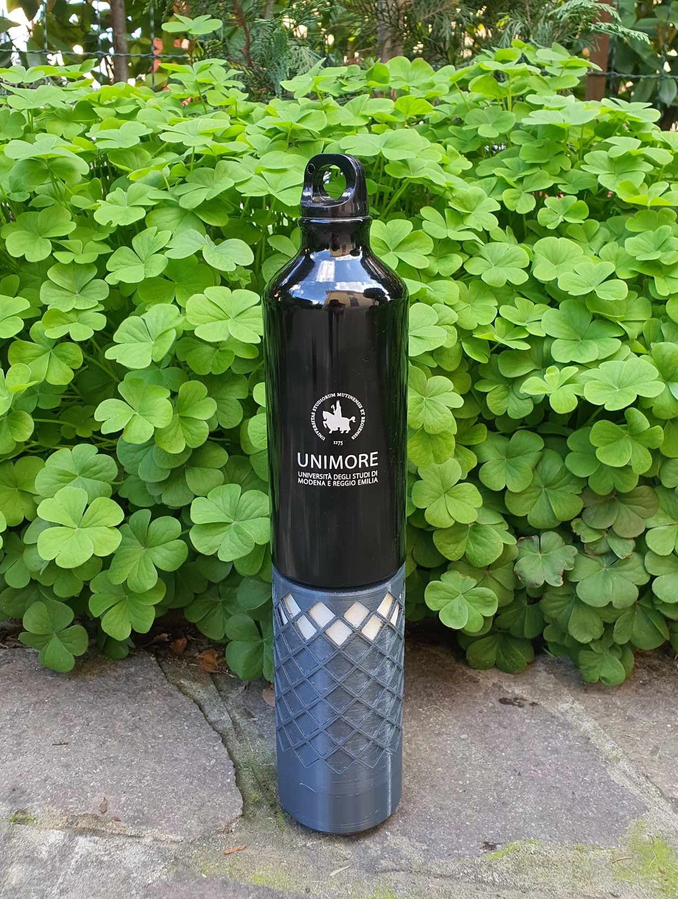
Why Unimore Smart Bottle?
In modern society, health and wellness are becoming an increasingly important part of culture
Wellness has now fully become part a company’s brand and identity. It shows the company’s effort in creating a better environment for both its workers and clients
Hydration is one most important factors for a person’s wellbeing

Slide 3
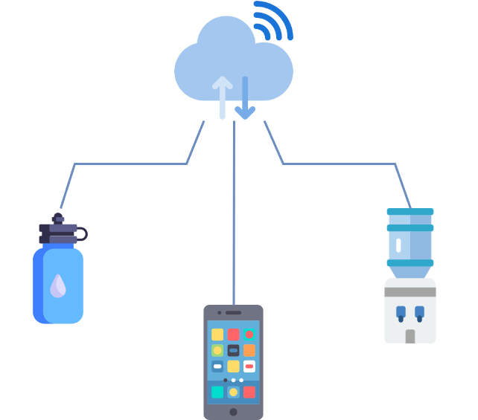
What does it do?
Allows the user to keep track of their water intake in an easy and engaging manner
Facilitates adopting correct drinking habits
Enables more efficient management and maintenance for a water cooler network

Slide 4
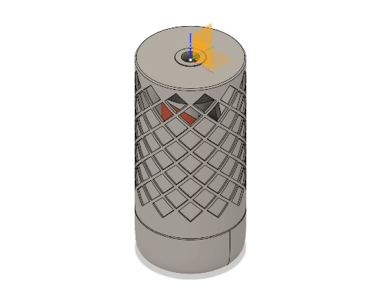
The Smart Bottle
The Bottle is designed with modularity in mind, this helped achieve upgradability and reperability, while maintaining all the required feature.
The design has a very user oriented set of feature designed designed to make all the interaction as friendly and non invasive as possible, like the magnet connector to charge the system or the notification led ring that provide feedback to the user.
Thank to its modular design and open source internal architecture, we encourage user to get their hans on the system customize it.

Slide 5
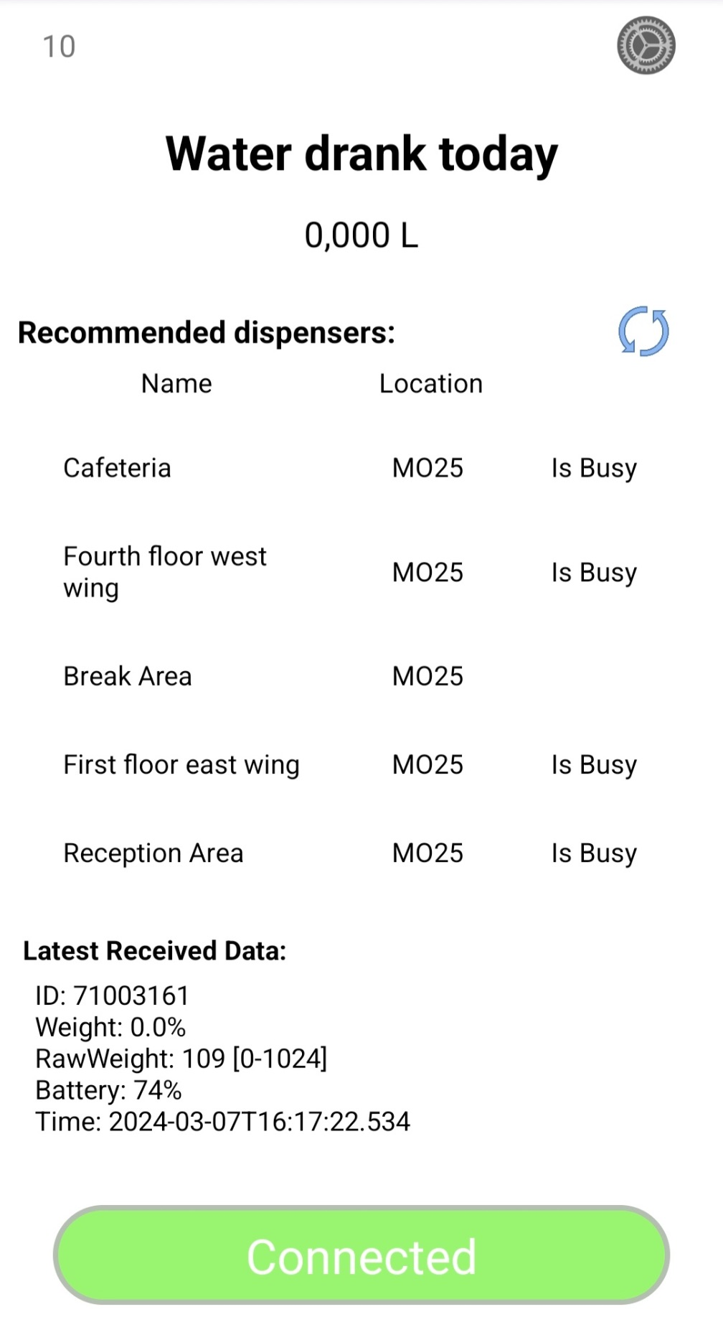
Unimore Smart Bottle app
The application is the main point for the user to interact with the system:
Shows how much water the user has drunk, so that they can reach their daily goal.
Helps the user navigate between the available dispenser, so they can have an overview of the relevant dispenser for them, while also provide information, like location and usage statues.

Slide 6
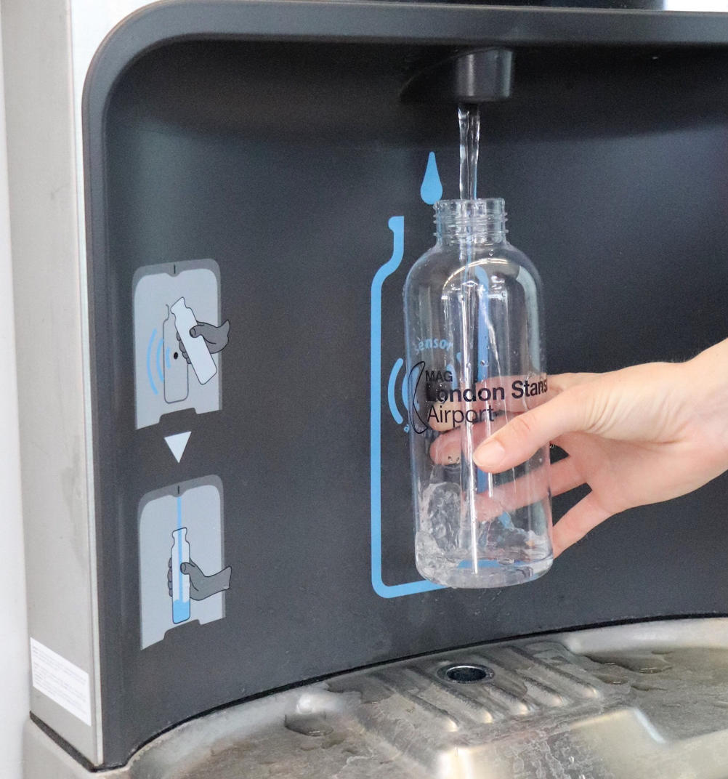
The dispensers
The water coolers can recognize the bottles being filled and collect data on the users.
This data is then used to help the user pick the water dispensers best suited for them when needed.
Redirects users to less busy coolers, allowing for better load distribution.

Slide 7
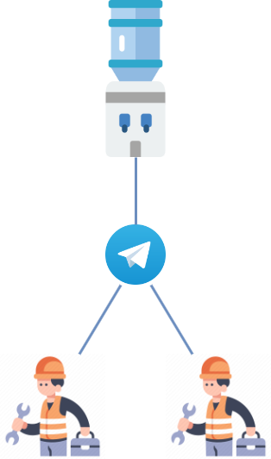
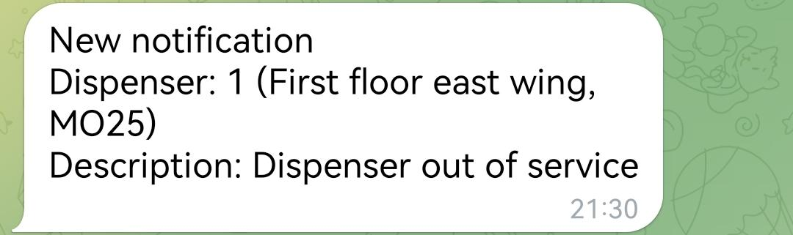
Telegram integration
Whenever a water cooler detects a fault and is unable to dispense water, it automatically sends a notification through telegram to the maintenance workers.
As soon as the issue has been resolved, a worker can easily update the status of the dispenser within the Telegram app

Slide 8
What can Unimore Smart Bottle do for you?
Data collection
Brand recognition
Promote healthy
drinking habits
Reduce plastic waste
Facilitate water cooler management and maintenance

